Slide 1
Modelling in Modelica

Slide 2
Modelling procedure
Define the system briefly. What kind of system is it? What does it do?
Make a sketch of the system including all relevant components and how they are connected.
Define communication, i.e., determine interactions and communication paths between these components. These include material, energy and information flows between components. Think about which variables are necessary to be “transported” from one component to the next component.
Sketch model classes for these components, or use existing classes from appropriate libraries.
Basic structuring in terms of variables. Which variables are of interest for the intended use of the model? Which variables should be considered as inputs, e.g. external signals, as outputs, or as internal state variables? Which quantities are especially important for describing what happens in the system? Which are time varying and which are approximately constant? Which variables influence other variables?
Stating equations and functions. State the governing laws of the application domains that are relevant for the model, i.e. conservation equations, e.g. energy and mass balances, and constitutive equations that relate quantities of different kind, e.g., relating voltage and current for a resistor. Formulate further relations, e.g. involving material properties and other system properties. Consider the level of precision and appropriate approximation trade-offs in the relationships.

Slide 3
Modelling procedure
Define interfaces, i.e., determine the external ports/connectors of each component for communication with other components (e.g. fluid ports that enable fluid flow between different components in the system). Formulate appropriate connector classes that allow a high degree of connectivity and reusability (e.g. one connector for two phase fluids, one for heat flows, one for signals, etc.), while still allowing an appropriate degree of type checking of connections.
Recursively decompose model components of “high complexity” further into a set of “smaller” subcomponents by restarting from step 2, until all components have been defined as instances of predefined types, library classes, or new classes to be defined by the user. E.g. could a heat exchanger be decomposed into three control volumes for the one fluid channel, the wall and the other fluid channel.
Formulate new model classes when needed, both base classes and derived classes:
Declare new model classes for all model components that are not instances of existing classes. Each new class should include variables, equations, functions, and formulas relevant to define the behavior of the component, as described in step 4.
Declare possible base classes for increased reuse and maintainability by extracting common functionality and structural similarities from component classes with similar properties.

Slide 4
Model structure
model ModelName “Optional short description” | Start of the model, includes <class type> <Identifier> <Short description>
Real A[N] “Optional description”; parameter Modelica.SIunits.Temp_C T_amb=10 “Ambient temperature in degC”; parameter Integer N=10 “Number of layers”; … | Declaration of variables
initial algorithm for i in N loop A[i]:=0; end for; | Optional initial algorithm section, only evaluated during initialization
algorithm for i in N loop A[i]:=i; end for; | Optional algorithm section Algorithms are evaluated sequentially, i.e. from top to bottom.
initial equation for i in N loop A[i]:=0; end for; | Optional initial equation section, only evaluated during initialization
equation L=x^2+y^2; der(m)=portA.m_flow+portB.mflow “mass balance”; connect(…)”connect equations”; | Equation section Equations maybe written in the desired order and maybe formulated explicitely or implicitely. Time derivatives are written using the der() operator.
annotation (…) | Annotations including positions of the graphical components, documentation of the model, version control, etc.
end ModelName; | End of model

Slide 5
Variable declaration
Prefix | Data type | Identifier
parameter | Integer | N[2,3] ;
constant | Real | n(start=n_start) ;
input | Boolean | myBoolean;
output | Modelica.SIunits.Temperature | …
flow | Modelica.SIunits.PressureDifference
stream | …
…
See example Lecture.GettingStarted.VariableTypes for more examples

Slide 6
Equations in Modelica
Modelica is equation based
Equations don’t need to be formulated as explicit equations
Most common operators are written as follows
See short script for further examples and language specifications.
Exponentiation | a^b | Returns Integer or Real values
Multiplication | a*b | Returns Integer or Real values
Division | a/b | Returns Integer or Real values
Addition | a+b | Returns Integer or Real values
Subtraction | a-b | Returns Integer or Real values
Sign | -a, +a | Returns Integer or Real values
Relational operators | a<b, a<=b, a==b, a>=b, a>b, | Returns Boolean value
Logical operators | a and b, a or b, not a | Returns Boolean value

Slide 7
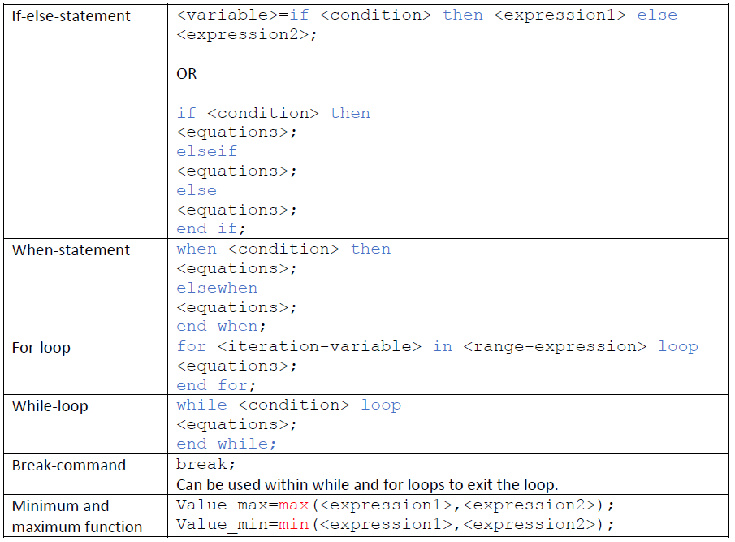
Conditional equations and loops

Slide 8
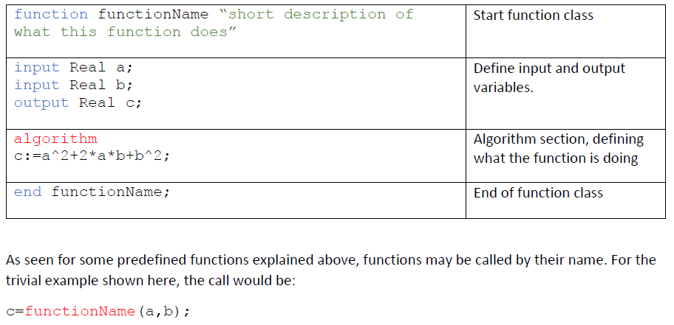
Functions

Slide 9
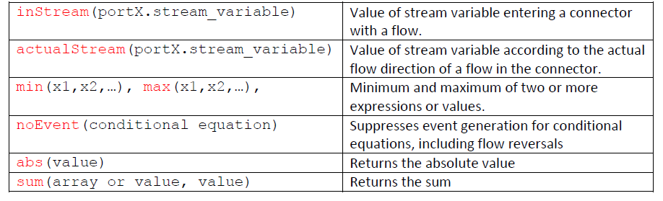
Predefined functions
Many predefined functions are available in Modelica. Some important examples are:

Slide 10
Media properties

Slide 11
Example: Heat exchanger

Slide 12
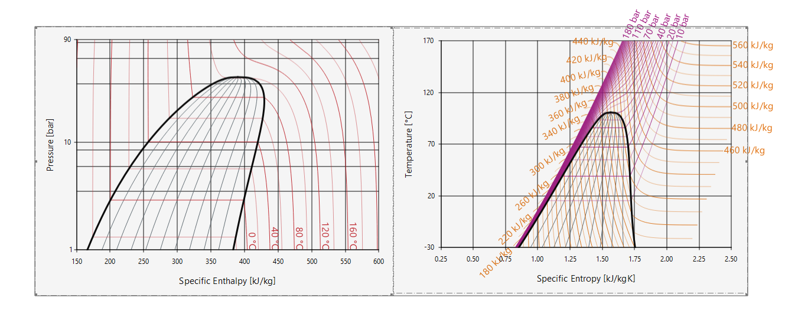
Media properties

Slide 13
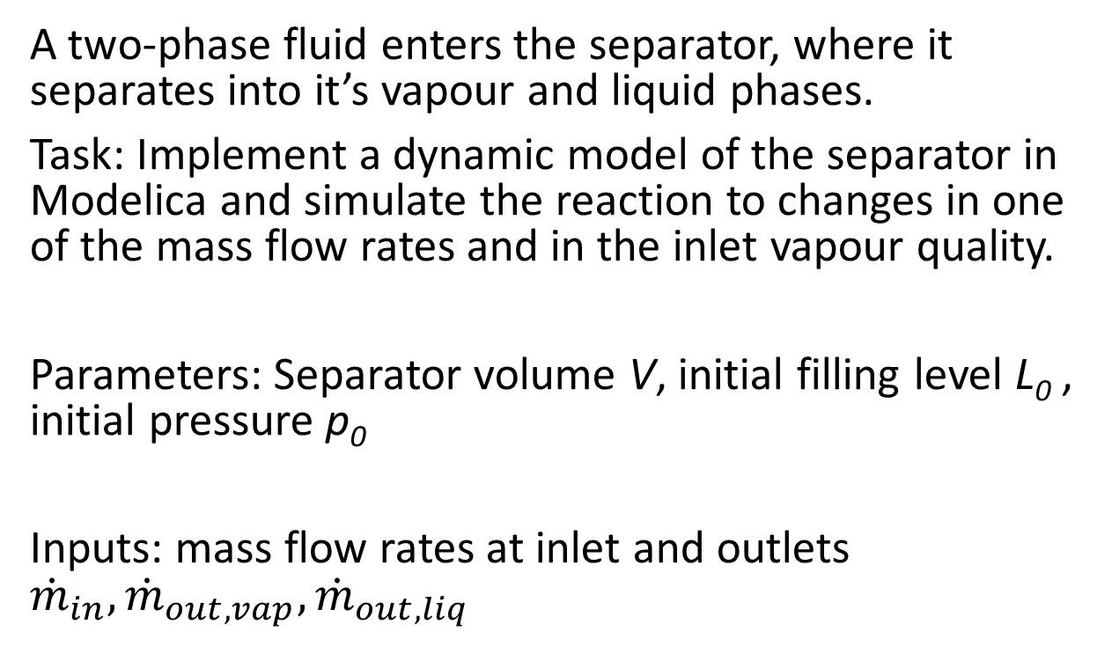
Exercise - Separator
vapour outlet
A two-phase fluid enters the separator, where it separates into it’s vapour and liquid phases.
Task: Implement a dynamic model of the separator in Modelica and simulate the reaction to changes in one of the mass flow rates and in the inlet vapour quality.
Parameters: Separator volume V, initial filling level L₀ , initial pressure p₀
Inputs: mass flow rates at inlet and outlets ${\dot{m}}_{in}, {\dot{m}}_{out,vap}, {\dot{m}}_{out,liq}$
inlet
V
p, h
L
liquid outlet

Slide 14

Exercise - Separator
vapour outlet
Mass balance (pure media)
$$\frac{dm}{dt}=V⋅\frac{dρ}{dt}={\dot{m}}_{in}+{\dot{m}}_{out,vap}+{\dot{m}}_{out,liq}$$
$$\frac{dρ}{dt}={\left(\frac{∂ρ}{∂h}\right)}_{p,x_{i}}⋅\frac{dh}{dt}+{\left(\frac{∂ρ}{∂p}\right)}_{h,x_{i}}⋅\frac{dp}{dt}$$
$$m=ρ⋅V$$
Energy balance
$$\frac{dU}{dt}={\dot{m}}_{in}⋅h_{in}+{\dot{m}}_{out,vap}⋅h_{out,vap}+{\dot{m}}_{out,liq}⋅h_{out,liq}+V⋅\frac{dp}{dt}$$
Can be transformed to:
$$\frac{dh}{dt}=\frac{1}{m}⋅\left({\dot{m}}_{in}⋅\left(h_{in}−h\right)+{\dot{m}}_{out,vap}⋅\left(h_{out,vap}−h\right)+{\dot{m}}_{out,liq}⋅\left(h_{out,liq}−h\right)+V⋅\frac{dp}{dt}\right)$$
Momentum balance (assume no pressure loss)
$$p_{in}=p_{out,vap}=p_{out,liq}$$
inlet
V
p, h
L
liquid outlet

Slide 15
Exercise - Separator
Additional tasks
Add a heat loss to the evaporator
Convert the model into a component
Add connectors for inlet and outlets
Define medium in connectors
Change energy and mass balance such that they use the information that is entering the component via the connector.
vapour outlet
inlet
V
p, h
Qdot_loss
L
liquid outlet

Slide 16
Write your own component
Modelica Workshop 24.-26.08.22

Slide 17
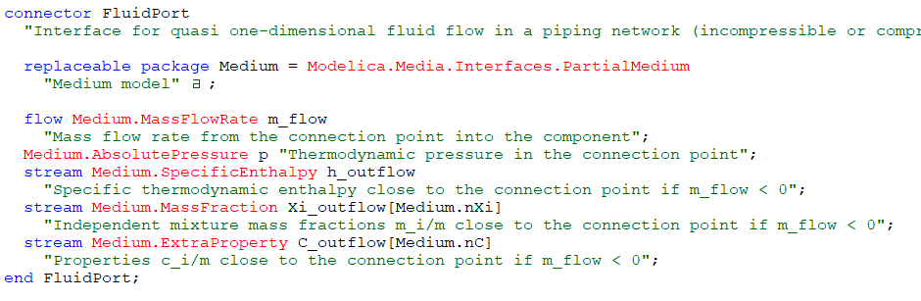
Stream variables
h transported with mass flow from upstream component
port_b.h_outflow
port_a.h_outflow
h transported with mass flow from upstream component

Slide 18
Example – Stream variables
inStream(port_a.h_outflow)
port_b.h_outflow
port_b.m_flow
a
p, h
b
port_a.m_flow
port_a.h_outflow
inStream(port_b.h_outflow)
actualStream(port.h_outflow) = if port.m_flow > 0 then inStream(port.h_outflow) else port.h_outflow;

Slide 19
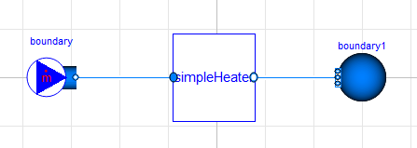
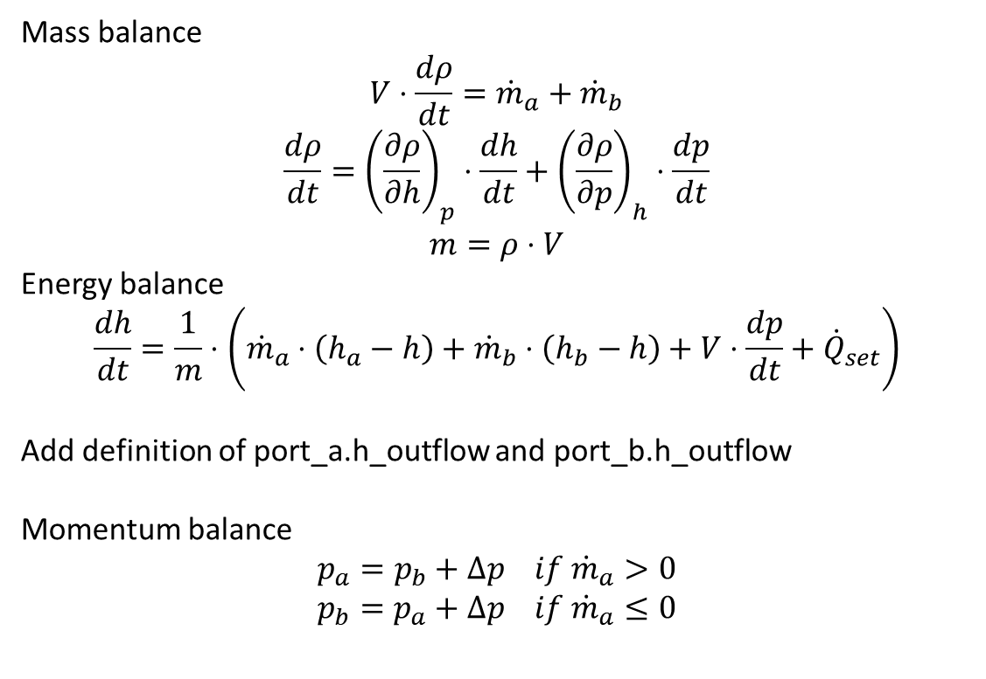
Exercise – Simple heater
Mass balance
$$V⋅\frac{dρ}{dt}={\dot{m}}_{a}+{\dot{m}}_{b}$$
$$\frac{dρ}{dt}={\left(\frac{∂ρ}{∂h}\right)}_{p}⋅\frac{dh}{dt}+{\left(\frac{∂ρ}{∂p}\right)}_{h}⋅\frac{dp}{dt}$$
$$m=ρ⋅V$$
Energy balance
$$\frac{dh}{dt}=\frac{1}{m}⋅\left({\dot{m}}_{a}⋅\left(h_{a}−h\right)+{\dot{m}}_{b}⋅\left(h_{b}−h\right)+V⋅\frac{dp}{dt}+{\dot{Q}}_{set}\right)$$
Add definition of port_a.h_outflow and port_b.h_outflow
Momentum balance
$$p_{a}=p_{b}+Δp if {\dot{m}}_{a}>0$$
$$p_{b}=p_{a}+Δp if {\dot{m}}_{a}≤0$$
Use actualStream(…)

Slide 20
Exercise – Simple heater
Build a tester for your component by adding external boundaries with the following specifications:
simpleHeater
medium = Modelica.Media.Water.StandardWater
Qdot_set=1000
volume=0.1
Modelica.Fluid.Sources.FixedBoundary boundary1
Medium = Modelica.Media.Water.StandardWater,
p=200000,
T=313.15
Modelica.Fluid.Sources.MassFlowSource_T boundary
Medium = Modelica.Media.Water.StandardWater,
m_flow=1,
T=298.15
Reverse the flow and verify that the model works.

Slide 21
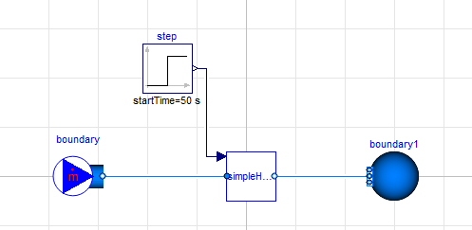
Exercise – Simple heater
Extend your model, so that Qdot_set is defined via a RealInput (Modelica Standard library – blocks – interfaces)
Build a new tester for the extended component.

